Slide 1
The Battle of Neighborhoods Exploring Venues in Jalandhar, India
By: Sakshi

Slide 2
Machine Learning(ML)
Machine learning is the scientific study of algorithms and statistical models that computer systems use to effectively perform a specific task without using explicit instructions, relying on patterns and inference instead. It is seen as a subset of artificial intelligence. Machine learning algorithms build a mathematical model based on sample data, known as "training data", in order to make predictions or decisions without being explicitly programmed to perform the task. Machine learning algorithms are used in a wide variety of applications, such as email filtering, and computer vision, where it is infeasible to develop an algorithm of specific instructions for performing the task. Machine learning is closely related to computational statistics, which focuses on making predictions using computers.

Slide 3
Steps Involved
in Machine
Learning
Defining a Problem
Preparing Data
Evaluating Algorithms
Improving Results
Presenting Results

Slide 4
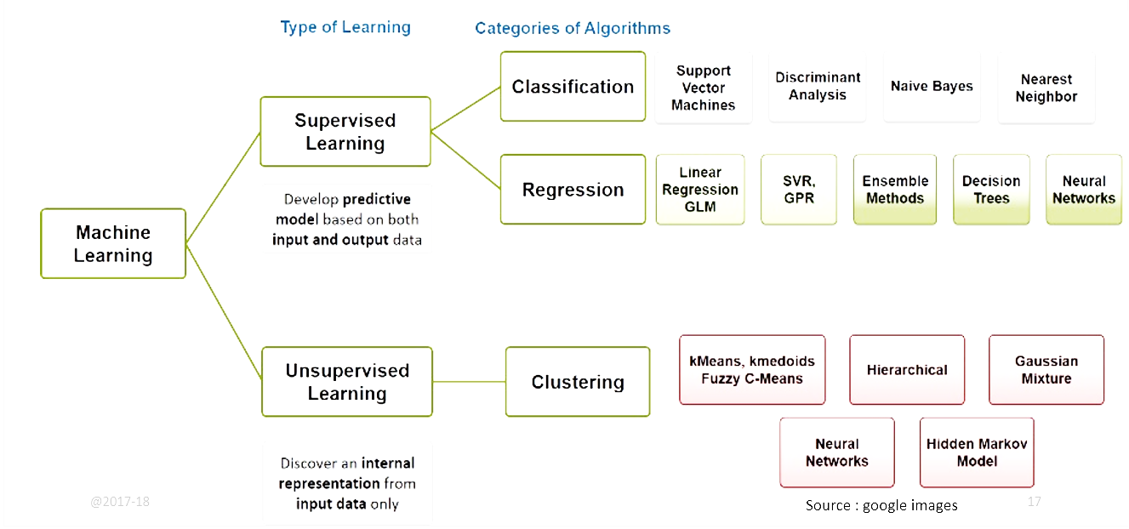
Categories of algorithms
in Machine Learning

Slide 5
Machine Learning
algorithm types
Types
Supervised Learning
Unsupervised Learning
Reinforcement Learning
Semi-Supervised Learning

Slide 6
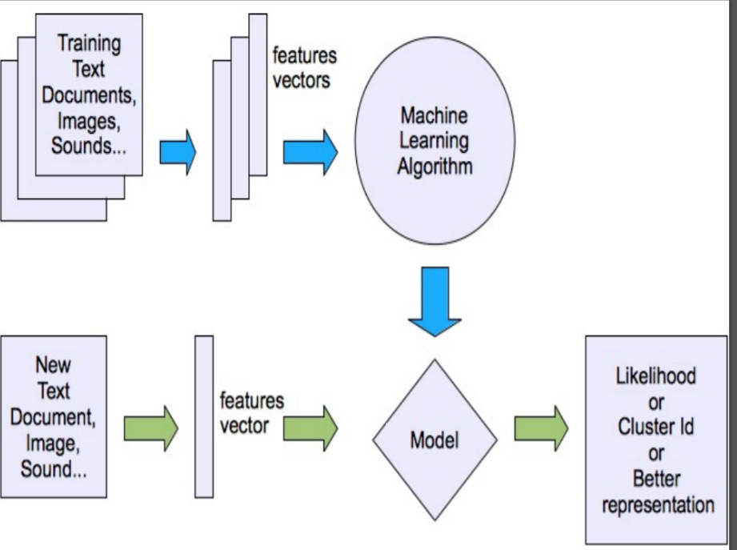
Unsupervised Learning
Unsupervised learning is a type of machine learning that looks for previously undetected patterns in a data set with no pre-existing labels and with a minimum of human supervision.

Slide 7
Unsupervised Learning
(continued)
Two of the main methods used in unsupervised learning are:
Principal Component
Cluster Analysis.
Cluster analysis is used in unsupervised learning to group, or segment datasets with shared attributes in order to extrapolate algorithmic relationships. Cluster analysis is a branch of machine learning that groups the data that has not been labelled, classified or categorized.
The Battle of Neighborhoods works on Cluster Analysis.
Some of the most common Clustering algorithms are listed below:
Hierarchical clustering
k-means
Mixture models
DBSCAN
OPTICS algorithm

Slide 8
Python
Python is an interpreted, high-level, general-purpose programming language.
Python was created by Guido van Rossum and first released in 1991.
Its object-oriented approach aims to help programmers write clear, logical code for small and large-scale projects.
Python is dynamically typed and garbage-collected.
It supports multiple programming paradigms, including procedural, object-oriented, and functional programming.
Python is often described as a "batteries included" language due to its comprehensive standard library.
Python interpreters are available for many operating systems.
Python uses whitespace indentation, rather than curly brackets or keywords, to delimit blocks.
Python uses duck typing and has typed objects but untyped variable names.
Python allows programmers to define their own types using classes, which are most often used for object-oriented programming.

Slide 9
Python for Machine
Learning
Python has libraries that enables developers to use optimized algorithms.
It implements popular machine learning techniques such as Regression, Classification, and Clustering.
Python is a popular platform used for research and development of production systems.
It is a vast language with number of modules, packages and libraries that provides multiple ways of achieving a task.
Python and its libraries like NumPy, SciPy, Scikit-Learn, Matplotlib are used in data science and data analysis. They are also extensively used for creating scalable machine learning algorithms.
It includes several implementations achieved through algorithms such as linear regression, logistic regression, Naïve Bayes, k-means, K nearest neighbour, and Random Forest.

Slide 10
Anaconda Navigator
Anaconda Navigator is a desktop graphical user interface (GUI) included in Anaconda distribution that allows users to launch applications and manage conda packages, environments and channels without using command-line commands. Navigator can search for packages on Anaconda Cloud or in a local Anaconda Repository, install them in an environment, run the packages and update them. It is available for Windows, macOS and Linux.
The following applications are available by default in Navigator:
JupyterLab
Jupyter Notebook
QtConsole
Spyder
Glueviz
Orange
RStudio
Visual Studio Code

Slide 11
Jupyter Notebook
Jupyter Notebook (formerly IPython Notebooks) is a web-based interactive computational environment for creating Jupyter notebook documents. The "notebook" term can colloquially make reference to many different entities, mainly the Jupyter web application, Jupyter Python web server, or Jupyter document format depending on context.
A Jupyter Notebook document is a JSON document, following a versioned schema, and containing an ordered list of input/output cells which can contain code, text (using Markdown), mathematics, plots and rich media, usually ending with the ".ipynb" extension.
A Jupyter Notebook can be converted to a number of open standard output formats (HTML , presentation slides , LaTeX , PDF, ReStructuredText , Markdown , Python) through "Download As" in the web interface, via the nbconvert library or "jupyter nbconvert" command line interface in a shell.

Slide 12
Introduction
To Project
The aim of the project is to identify venues in Jalandhar , India based on their rating and average prices. In this project, we will identify various venues in Jalandhar, India, using Foursquare API and Zomato API , to help visitors select the restaurants that suits them the most.
Whenever people visit a city they start looking for places to visit during their stay. There primarily look for places is based on the venue ratings across all venues and the average prices so that the location fits in their budget.
Here, we'll identify places that are fit for various individuals based on the information collected from the two APIs and Data Science. Once we have the plot with the venues, any company can launch an application using the same data and suggest users such information.

Slide 13
Data Collection
from API
To begin with, we take a look at Jalandhar on the Map using the folium library.
We also fetch the data from two different APIs.
Foursquare API: We will use the Foursquare API to fetch venues in Jalandhar starting from the middle up to 20 Kilometres in each direction.
Zomato API: The Zomato API provides information about various venues including the complete address, user ratings, price for two people, price range and a lot more.

Slide 14
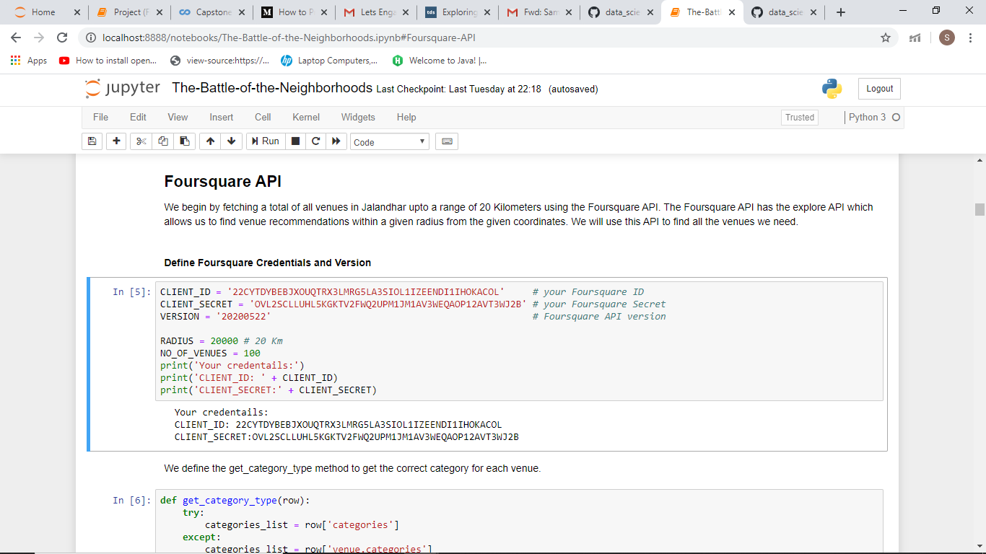
Foursquare API
We fetch a total of all venues in Jalandhar up to a range of 20 Kilometres using the Foursquare API. The Foursquare API is the explore API which allows us to find venue recommendations within a given radius from the given coordinates. We use this API to find all the venues we need.

Slide 15
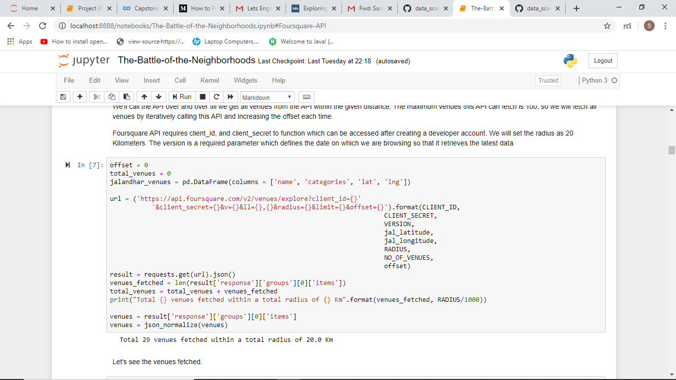
Foursquare API
(continued)
We call the API over and over till we get all venues from the API within the given distance. The maximum venues this API can fetch is 100, so we will fetch all venues by iteratively calling this API and increasing the offset each time.

Slide 16
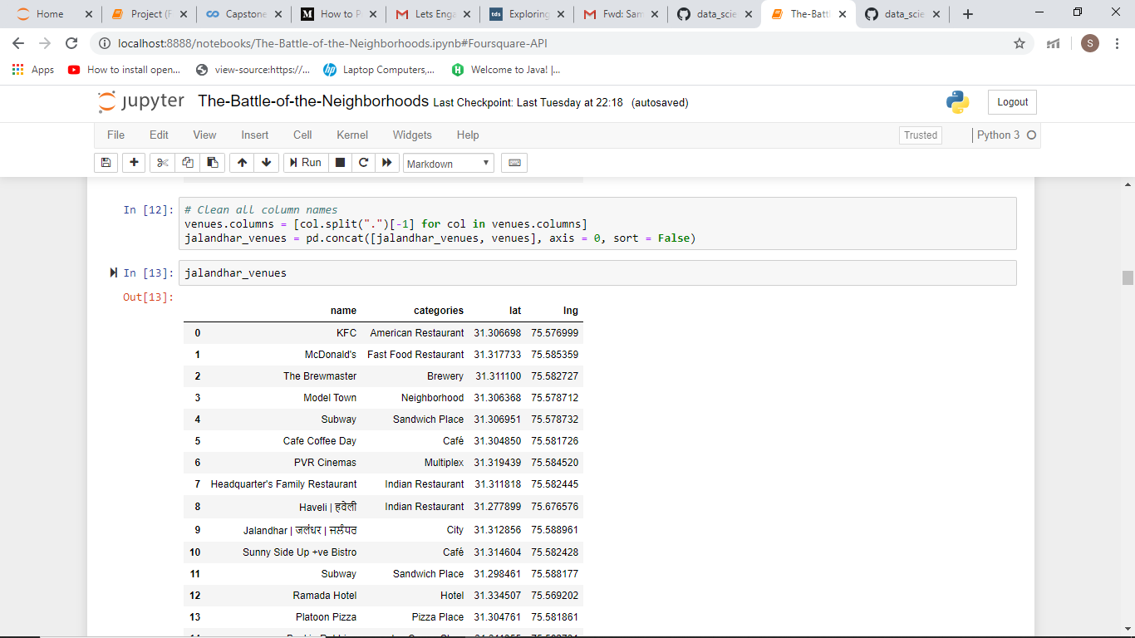
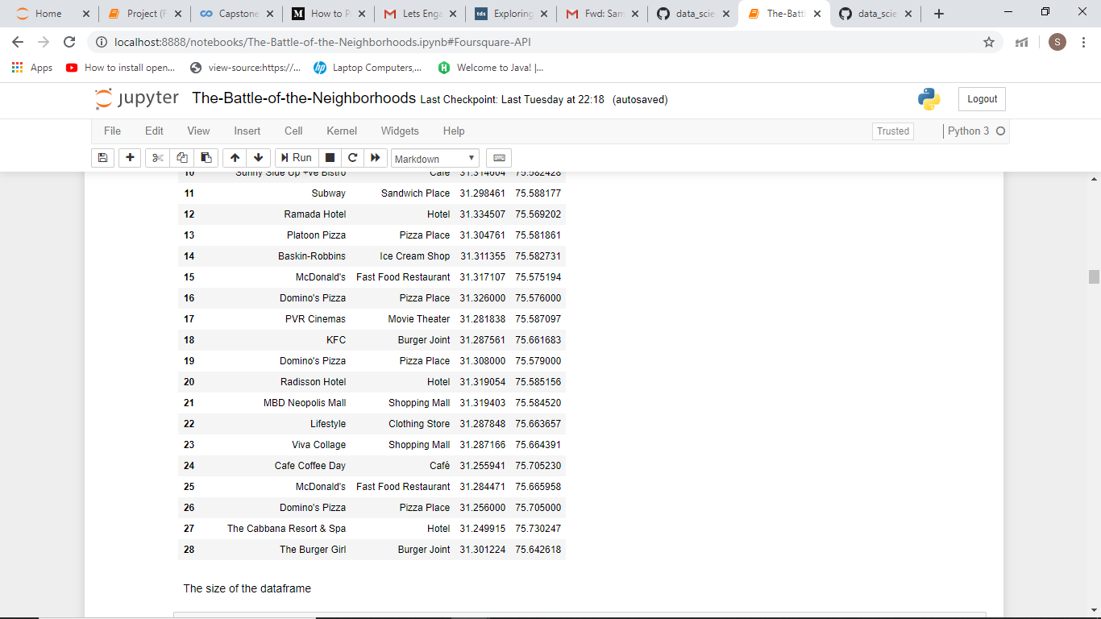
Foursquare API
(continued)
Venue Data fetched from Foursquare API :

Slide 17
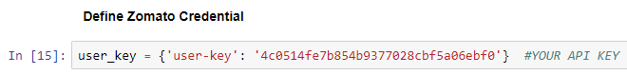
Zomato API
The Zomato API allows using its search API to search for any given venue based on certain search filters such as query, latitude, longitude and more. Zomato also requires a Zomato user key which can be accessed with a developer account.
We use the name, latitude, and longitude values of various venues fetched from Foursquare API to use the search API and get more information regarding each venue.

Slide 18
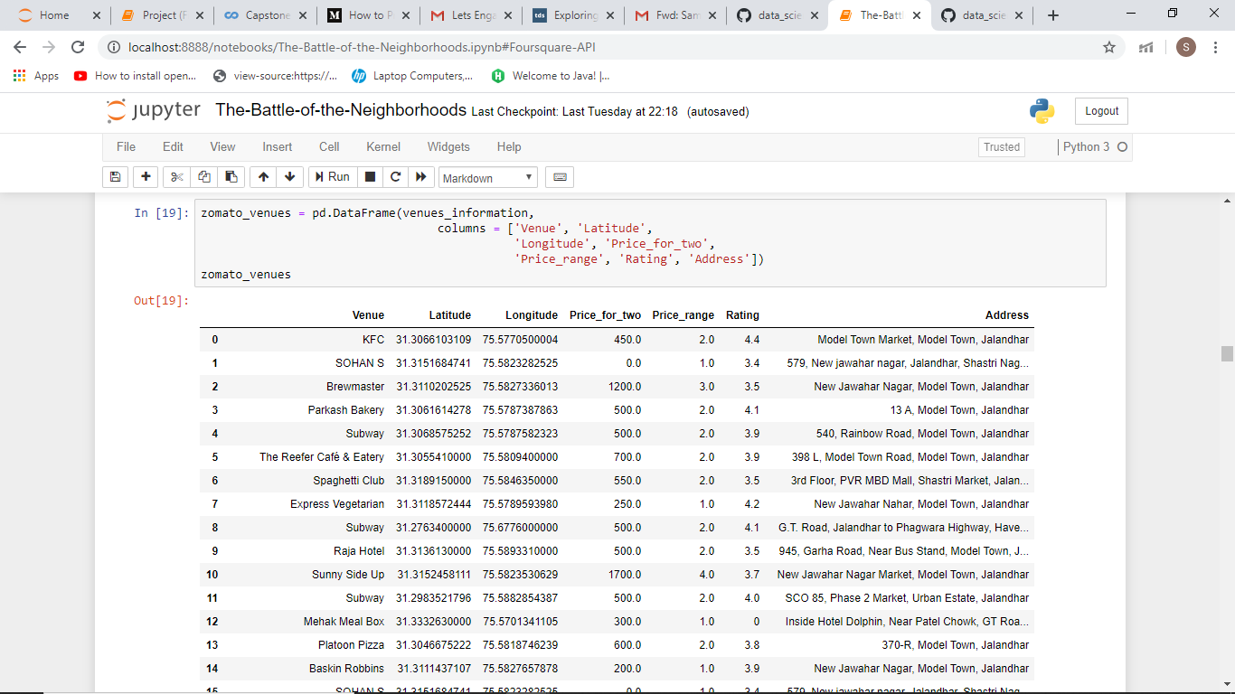
Zomato API
(continued)
Venue Data fetched from Zomato API :

Slide 19
Data Cleaning
The data from multiple resources might not always align. Thus, it is important to combine the data retrieved from multiple resources properly.
The data points are first plotted on the map. Then combine data points that have their latitude and longitude values very close to one another. From the remaining selected venues, inspect the venues to ensure that any remaining mismatched venues are also removed from the final dataset of venues before any analysis begins.

Slide 20
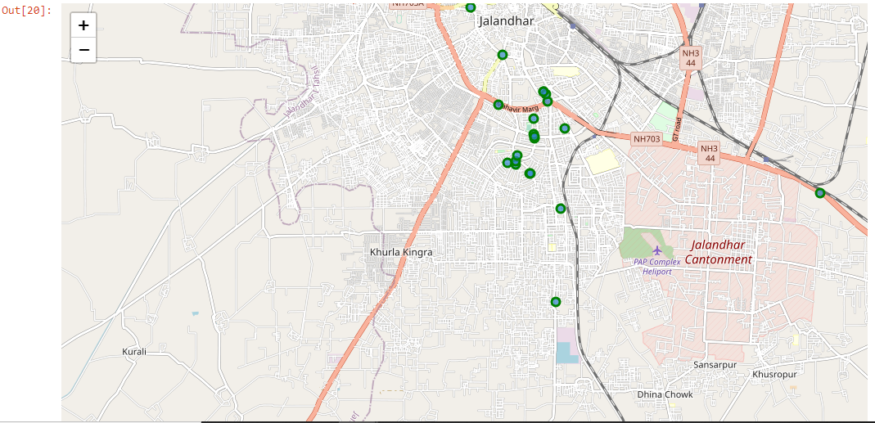
Plotting Foursquare
data on Map

Slide 21
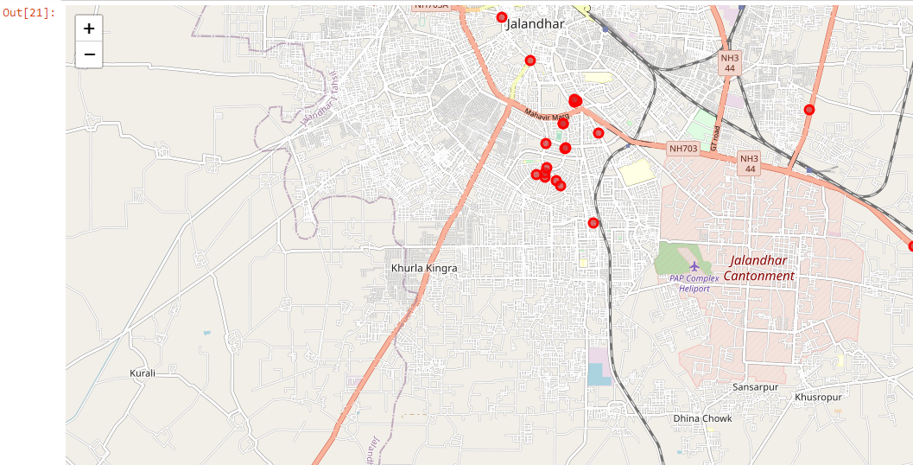
Plotting Zomato
data on Map

Slide 22
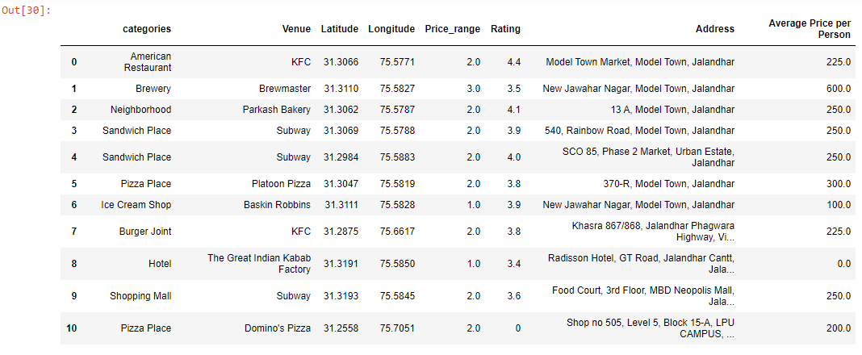
Selected Venues
from both APIs
These are some venues identified by both Foursquare and Zomato :

Slide 23
Methodology
The project aims at identifying the venues in Jalandhar based on their rating and average costs. This would enable any visitor to identify the venues he/she wants to visit based on the rating and their cost preferences.
As a first step, we retrieved the data from two APIs (Foursquare and Zomato). We extracted venue information from the centre of Jalandhar, up to a distance of 20 Km. The latitude and longitude values are then used to fetch venue rating and price from Zomato.
Secondly, we then explored the data retrieved from the two APIs on the map and identified the top category types. The data from the two sources is carefully combined based on the name, latitude and longitude values from the two sources. The final dataset would include the rating and price values for each venue.

Slide 24
Methodology
(continued)
Thirdly, we analyse the data that we created based on the ratings and price of each venue. We identify places where many venues are located so that any visitor can go to one place and enjoy the option to choose amongst many venue options .
Lastly, we cluster the venues based on the available information of each venue. This will allow us to clearly identify which venues can be recommended and with what characteristics.
Finally, we discuss and conclude which venues to be explored based on visitor requirement of rating and average cost.

Slide 25
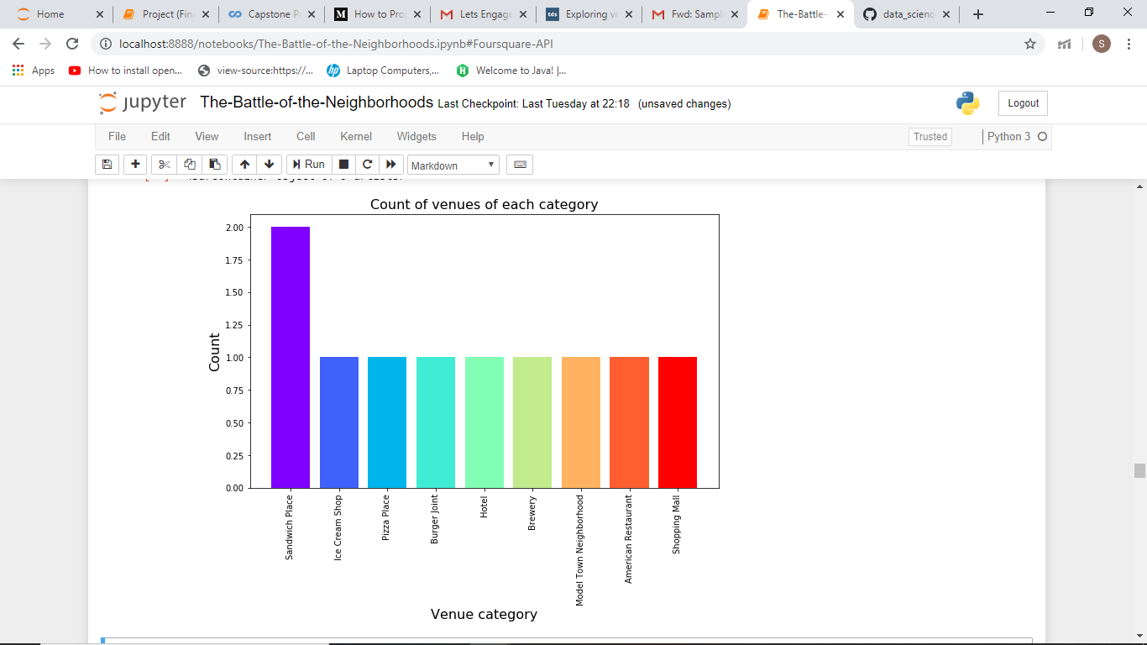
Analysis
The different Venue Categories analysed from the data :
As the data retrieved for venues of Jalandhar was not very large , It can be observed from bar-chart that except Sandwich Place Category, all other Venue Categories have only one venue each.

Slide 26
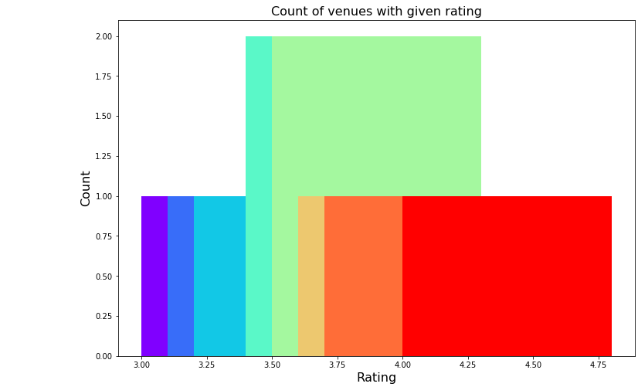
Analysis
(continued)
The ratings are plotted on the Bar-Plot to see the most common ratings :
From the plot it is clear that majority venues have a rating between 3.5 to 4.

Slide 27
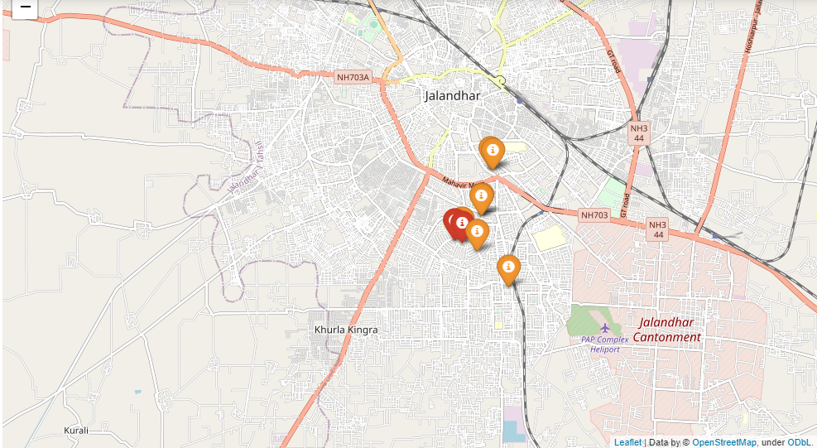
Analysis
(continued)
Venues are plotted on the basis of ratings differentiated by colour:
Low: dark green, Okay: green, Good: orange, Very Good: red
From map ,
It appears that many venues are located in Model Town with rating above 3.5.

Slide 28
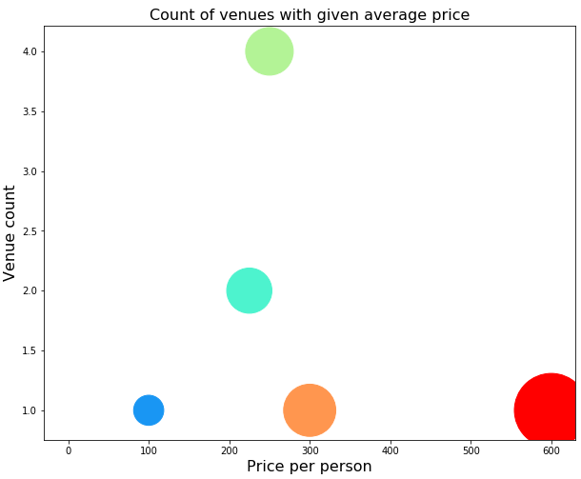
Analysis
(continued)
A scatter plot is plotted between the price and the count of venues with that average price :
From the plot we can see that a most venues have an average price between Rs 200 and Rs 300.

Slide 29
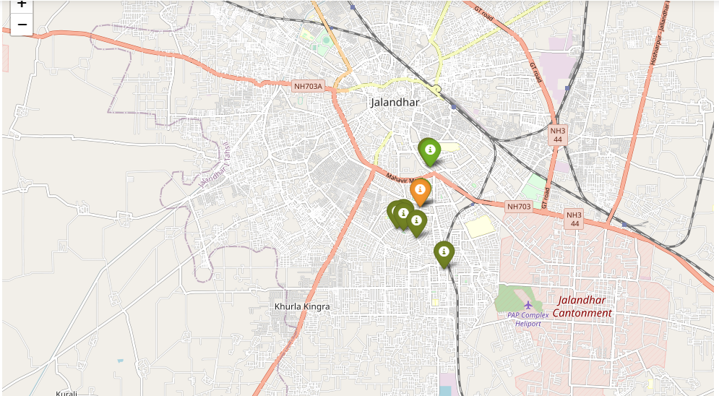
Analysis
(continued)
We use the Price_range column to plot the venues on a map. Venues with lower price range are represented with green colour and high price range with red colour.
Venues with good ratings are located in Model Town.
Model Town seems to have average to high priced venues.

Slide 30
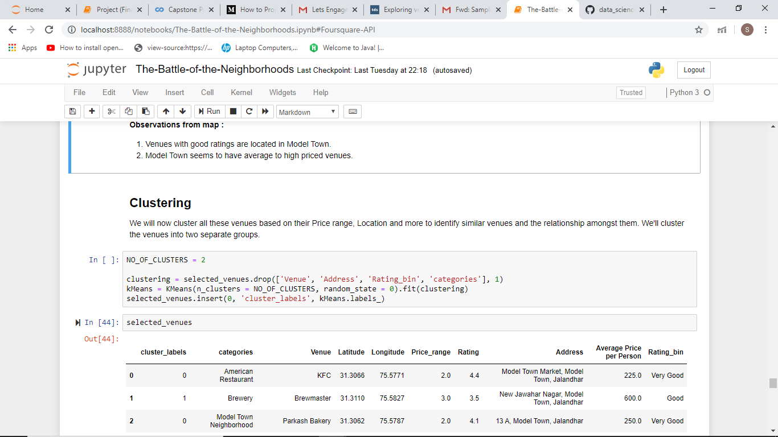
Clustering
We cluster all these venues based on their Price range, Location and more to identify similar venues and the relationship amongst them. We cluster the venues into two separate groups.
Algorithm Used : K-means Clustering

Slide 31
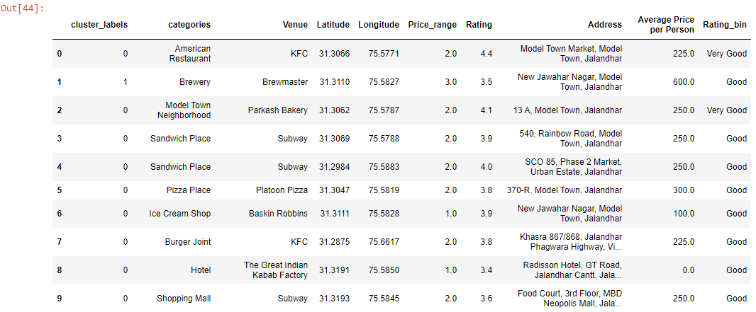
Clustering
(continued)
Venues labelled using K-means algorithm:

Slide 32
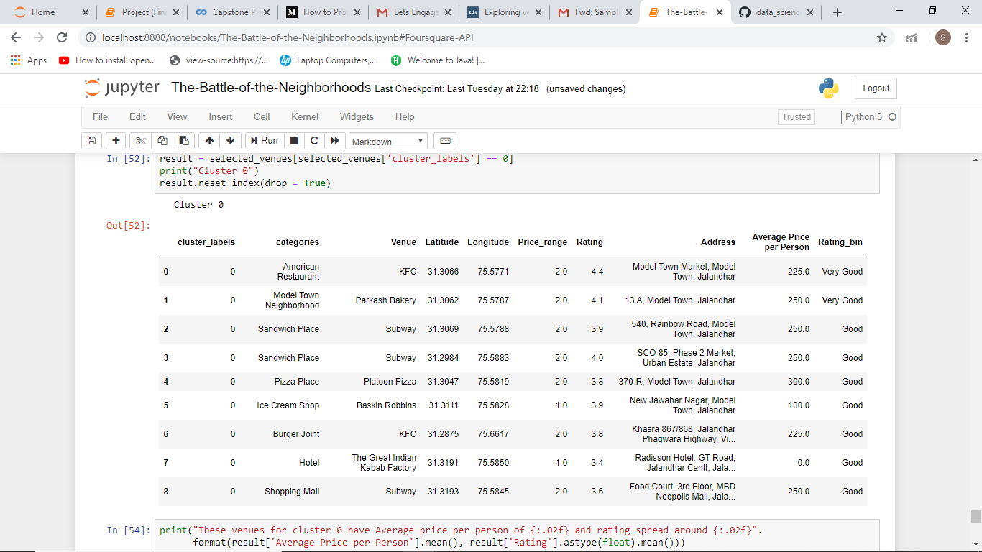
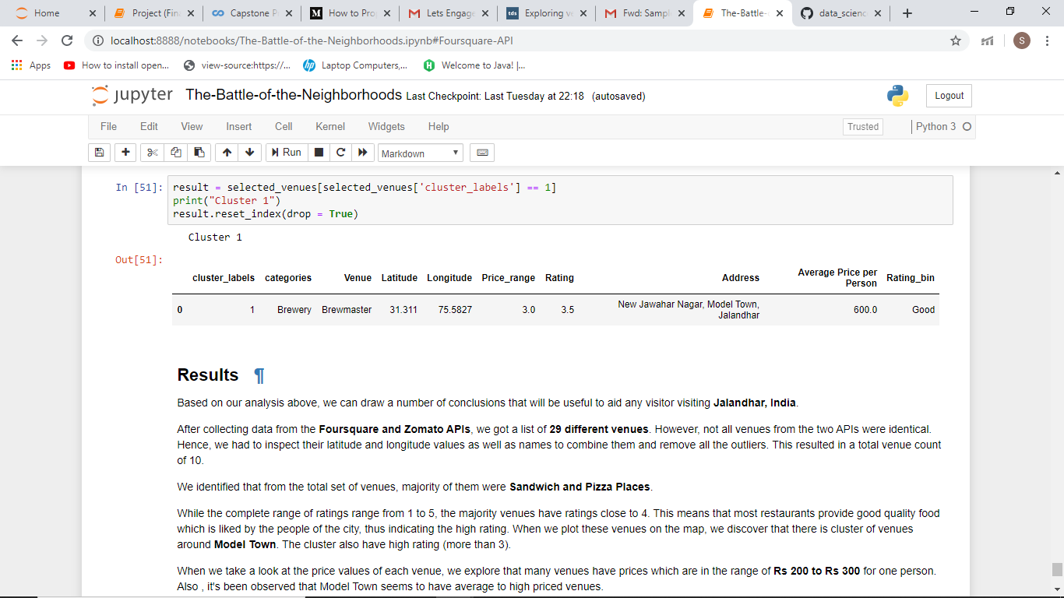
Clustering
(continued)

Slide 33
Results
Based on our analysis, we can draw a number of conclusions that will be useful to aid any visitor visiting Jalandhar, India.
After collecting data from the Foursquare and Zomato APIs, we got a list of 29 different venues. However, not all venues from the two APIs were identical. Hence, we had to inspect their latitude and longitude values as well as names to combine them and remove all the outliers. This resulted in a total venue count of 10.
We identified that from the total set of venues, majority of them were Sandwich and Pizza Places.
While the complete range of ratings range from 1 to 5, the majority venues have ratings close to 4. This means that most restaurants provide good quality food which is liked by the people of the city, thus indicating the high rating. When we plot these venues on the map, we discover that there is cluster of venues around Model Town. The cluster also have high rating (more than 3).

Slide 34
Results
(continued)
When we take a look at the price values of each venue, we explore that many venues have prices which are in the range of Rs 200 to Rs 300 for one person. Also , it's been observed that Model Town seems to have average to high priced venues.
Finally, through clusters we identified that there are many venues which are relatively lower priced but have an average rating of 3.88.
So, If you're looking to explore the city and have no specific criteria to decide upon the places you want to visit, you should try Model Town.
A company can use this information to build up an online website/mobile application, to provide users with up to date information about various venues in the city based on the search criteria (name, rating and price).

Slide 35
Conclusion
The purpose of this project was to explore the places that a person visiting Jalandhar could visit. The venues have been identified using Foursquare and Zomato API and have been plotted on the map. The map reveals that the major area in Jalandhar to visit is Model Town. Based on the visitor's venue rating and price requirements, he/she can choose places.

Slide 36
Thank You

